Slide 1
IMPLEMENTATION OF MULTI-USER SECURE CHATROOM WITH ENCRYPTION USING UDP AND SMTP
Presentation by,
Madireddy KalyanVenkat
Reg.No.122003141

Slide 2
Objectives Of Project
To demonstrate the role of network communication using the UDP/IP Suite i.e User Datagram Protocol operating on top of the Internet Protocol.
To demonstrate the role of Simple Mail Transfer Protocol in assuring the data privacy, Integrity and message sending capability.
To enrich the importance of data security in the present day networking world through the Encryption and decryption techniques.
To give users, the assurance of safety, reliability and friendly environment, to use the application through the refreshed Graphical User Interface

Slide 3
Problem Statement
The project is to create a chat room with ‘n’ number of users and users to enable the other users, to chat or discuss with each others. To develop an instant messaging solution to enable users to seamlessly interact with each other. The chat room created should be secured, and this security should be maintained by OTP verification method of SMTP server. The messages sent and received in the chatroom should maintain Integrity and Protection with the help of Encryption and Decryption methods available. The usage of this application should give the freedom of choice to users to personalize their own application in the way they wanted and at the same time making the use of the application Simple and easy.

Slide 4
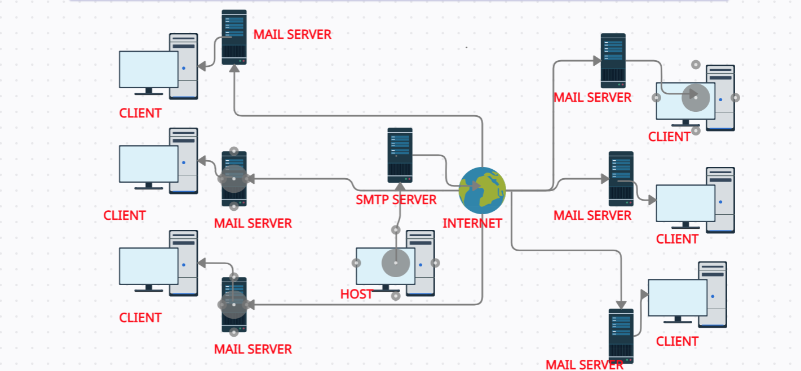
OUTLINE DIAGRAM of SMTP WORKING

Slide 5
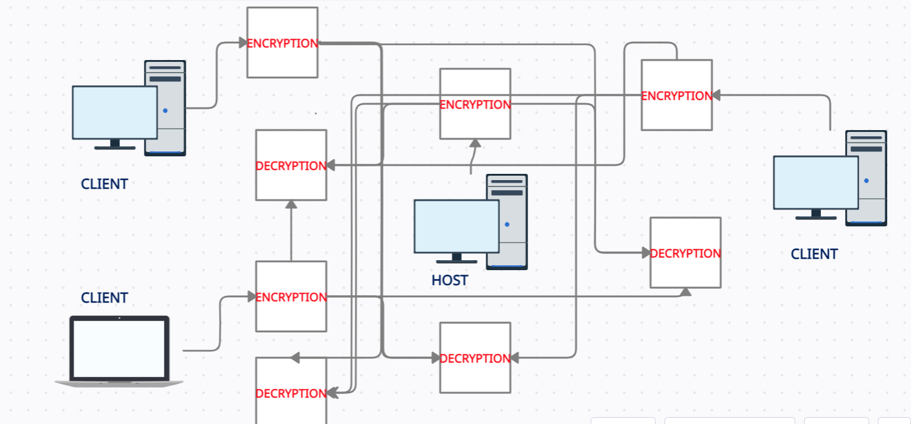
OUTLINE DIAGRAM of UDP along with Encryption-Decryption

Slide 6
Flow Chart
Can be done multiple times
Host Authentication
OTP verification through SMTP mail
Chat room created & binded to local IP
Client Authentication
OTP verification through smtp mail
Client joined in the chatroom and enter his details
Will be happening
Always
Will be happening
Always
The User types the message and presses send
The message typed will be encrypted
The message will be sent to everyone in the chatroom
All the participant’s
of the chatroom receives the message
The message will be decrypted using the user key
The message along with the sender’s name get’s added to all the chat boxes

Slide 7
WORKING
Initially, the Host authenticate himself to the application with the help of the OTP received through a mail using the SMTP server.
After he authenticates himself, The host will be asked to enter his name and the chatroom name that he would like to create.
The chatroom created will be on the certain port specified in the application and will bind to the local host IP address i.e host address and gets itself running.
Now, the users who wants to join in the respective chatroom will also be asked to verify their identities through the OTP received via Mail.
Once the authentication is complete, The users willing to join the chatroom created by the host has to enter their name and the IP address of the host who created the chatroom.
In the similar way multiple number of users can at a time join the chatroom. Once the new user is joined in the chatroom at a time say ‘k’ ,then all the users of the chatroom who are existing to the time before that say’k-1’ will be able to see through the message that user named ’xyz’ has joined.
Any user of the chatroom can type the message and send in the room to everyone. The message sent by any user will be received along with their name in front in other participant’s chat box of the room.

Slide 8
WORKING
The message before sending by any user will be encrypted using standard AES encryption technique, making sure that no third party gets their hands on the data.
This message while receiving in the chat box of the room of participant’s will be decrypted using the key that is used for encryption, This decrypted message will be added to the text boxes of the participant’s of the room.
Apart from this, the users will also be able to personalize their chat room application through operations like changing the colour of the application, giving double –tone colour to the application, changing the font style, font colour, font size etc.
Other operations includes seeing the no. of visits made to the application so far, changing their profile status, clearing their chat box, seeing all other participants of that particular chatroom, copying the text in to a file and so-on.
Now, we’ll se the brief logic, to provide this we show the same in 3 methods
LOGIC
In sending mail:-
The mail-id typed in the app’n will be taken as parameter to call the send mail method of the imported package. Which sets up the properties required and adds the requirements like the sender’s mail address, password and Subject to the mail. The body of the mail would be the random generated string of 6 digits which will also be stored for the verification in the future.

Slide 9
WORKING
In sending/receiving part:-
Message sending by host:- Once the text is typed and button send is clicked, the text will be converted into the encrypted text and this text, acting as a parameter will call the broadcast method which will convert this text into the datagram packets and loops it for every client in the chatroom. Once it sends for every client it also decrypts the text and adds in to its own chat box.
Message sending by client:- Once the text is typed, button clicked, converted to the encryptred form, calls the send_to_host method which will send the text to the host through the udp send method.
Message receiving by host:- Host will be receiving two types of messages, one the encrypted form of text typed and sent by the client-in this case the host simply calls the broadcast method. The other type received from the particular client is the details of the client which will be used to identify the client’s actions.
Message receiving by client:- Client receives two types of messages, One type is the chatroom name sent in the special format from the host as the confirmation for entry in to the chatroom. The other is from client by broadcast method. In this case client after receiving message will decrypt the text and adds it to the text box of their own.

Slide 10
WORKING
In Encryption-Decryption:-
The message typed will be stored in a string and passed as a parameter along with the user defined key string. This method called converts the key string to the secretkeyspec with the UTF-8 bytes and SHA-1 message digest instance. And the new cipher with AES will be called in encrypt mode along with base 64 encoder to covert the message into the encrypted text and this will be returned to the caller. While in decryption the same secret key spec will be used in the creation of the cipher with the AES decryption mode and Base 64 decoder will be used to decode the encrypted text to the normal text.
CONCLUSION
The smooth running, easily portable and flexible with the system application created uses the concepts like UDP, SMTP and AES encryption decryption. And all these concepts are used in a well resource full manner to bring the best out of them in creating this application. The GUI also helps in making the application unique from one other. This application maintaining the data integrity, Privacy and safety creates the user friendly environment for the user.

